Slide 1
Desktop Application Programming
Joheen Chakraborty
John P. Stevens High School, Edison, NJ

Slide 2

The Problem
Hired by national office of FBLA-PBL
Needs a program to manage membership data
  add, delete, change members
Needs two reports
  Balance Report
  Senior Report
Should be easy to navigate and user-friendly

Slide 3
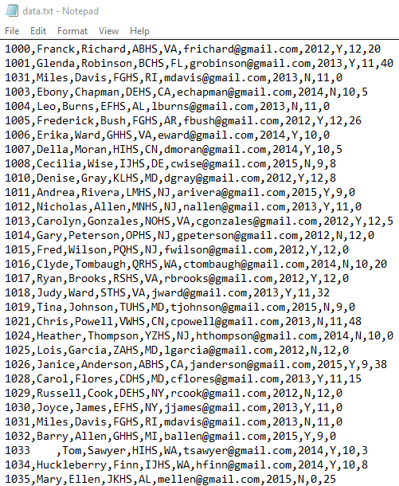
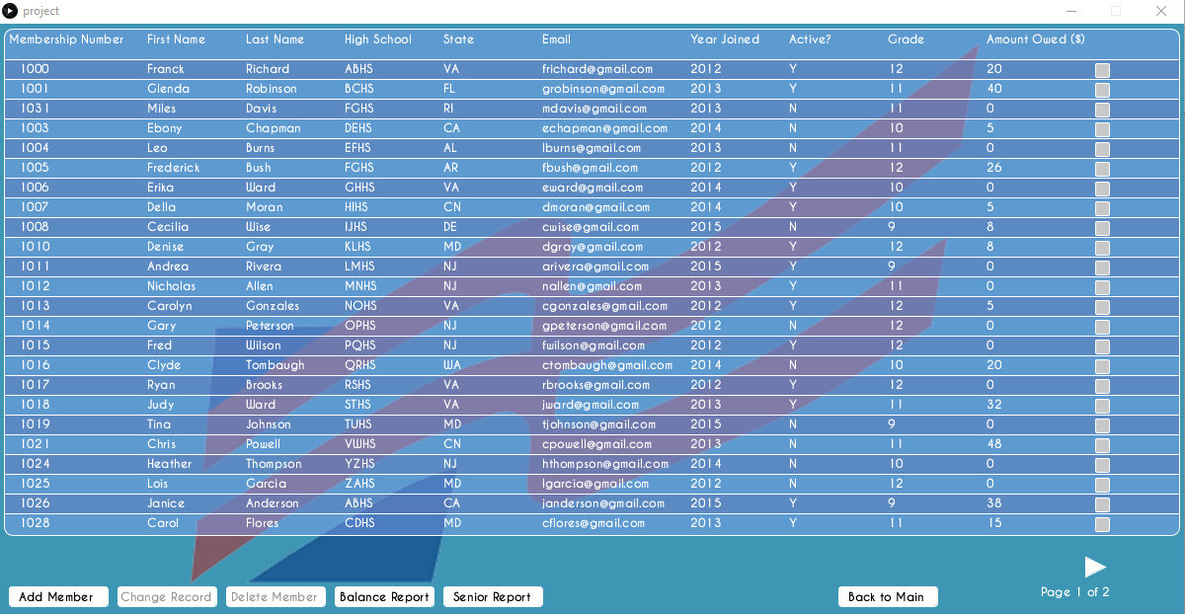
Why is the program useful?
Organizes large amounts of data
Allows easy manipulation
Easy to sort members and create reports
More user-friendly than a text file or database

Slide 4


Program Documentation: Open Source Components
Processing 3.0.1 (with Java)
https://processing.org/
Java libraries (https://docs.oracle.com/javase/7/docs/api/):
  Filereader
  Bufferedwriter, Filewriter
  Collections, Comparator
  Print, BufferedImage

Slide 5
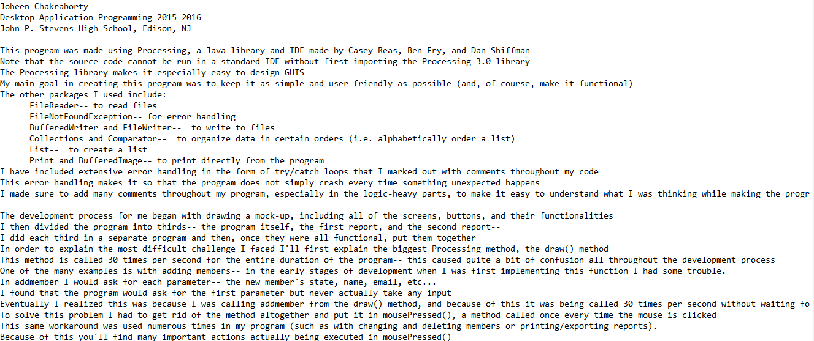
Program Documentation: Components Developed
readme.txt
  purpose of the program
  software used for development
  instructions for running the program

Slide 6
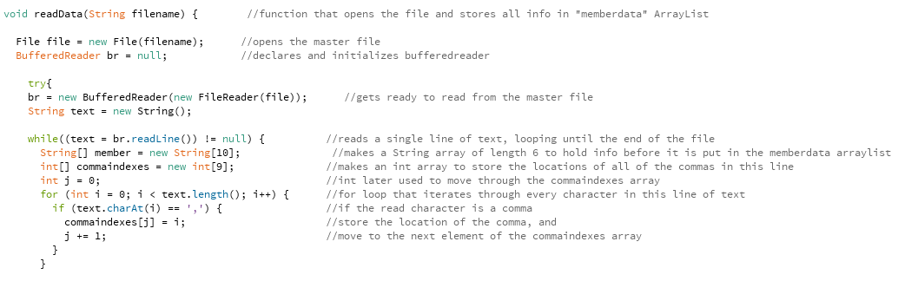
Program Documentation: Components Developed
Source code
  comments explaining program logic

Slide 7
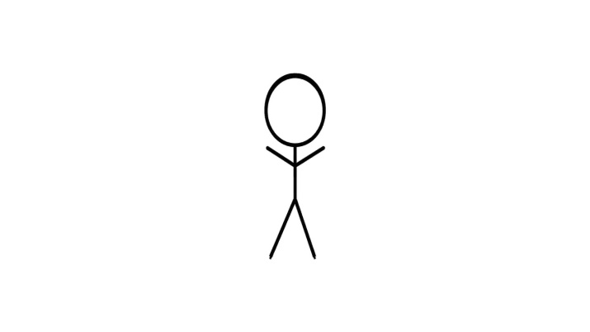

Planning Process
Actors
Use cases
User stories
As a ______, I want to do ________

Slide 8
Add member
FBLA National Officer
Delete member
Change a member’s data
FBLA Advisor
Report balance-owing members
FBLA State Officer
Report senior members
FBLA Chapter Officer

Slide 9
Add member
Click “Add Member” Button
Enter member data
Press “Save Changes”
Delete member
Select member to delete
Click “Delete Member“ Button
Press “Save Changes”
Change a member’s data
Select a member
Click “Change Member” Button
Input new data
Press “Save Changes”
Report balance-owing members
Press “Balance Report” Button
Press “Export” button
Enter filename and location
Press “Print” button
Report senior members
Press “Senior Report” Button
Press “Export” button
Enter filename and location
Press “Print” button

Slide 10
Program Input/Output
Master file name/location
Load data from master file
Member data printed on screen
User selects an action
Add/Delete/Change Member
Program goes to screen based on selected action
User adds or modifies member data
Add/Change Member
Program adds or modifies member data
User presses a Report button
View Balance or Senior Report
Program goes to Report page
User exports and prints Report
Export or Print Report
Creates a file or sends a print request to printer

Slide 11
Program Started
Program Flow Diagram
Get master file location
Open file, read member data, and store in ArrayList
User
Selects “Change
Member”
Yes
Get info from user
Update member data and master file
A
Display member data
No
No
User selects a member
User
Selects “Delete
Member”
Yes
Yes
Remove member from data and update master file
A
No
No
User
selects “Add
Member”
Yes
Get info from user
Add member data to the master file
User selects “Back to Main”
No
User selects a report
Yes
Display respective “report” page
User exports or prints
Export or print, respectively

Slide 12
Program Structure: Data Structure
Member 1
Membership No.
First Name
Last Name
School
State
Email
Year Joined
Active?
Grade
Amount Owed
Member 2
Membership No.
First Name
Last Name
School
State
Email
Year Joined
Active?
Grade
Amount Owed
Member 3
Membership No.
First Name
Last Name
School
State
Email
Year Joined
Active?
Grade
Amount Owed

Slide 13
Program Started
Program Structure:
Control Structure
setup()
draw()
keyPressed()
readData()
printMemberData()
draw()
mousePressed()
Manage member data
Report member data

Slide 14
Manage member data
“Add Member”
button
“Delete Member”
button
“Change Member”
button
keyPressed()
mousePressed()
keyPressed()
mousePressed()
writeData()
mousePressed()
writeData()
printMemberData()
writeData()
printMemberData()
printMemberData()

Slide 15
Report member data
“Senior Report”
button pressed
“Balance Report”
button pressed
createSeniorReport()
createBalanceReport()
printSeniorReport()
printBalanceReport()
mousePressed()
mousePressed()
keyPressed()
keyPressed()
exportSeniorReport()
exportBalanceReport()
mousePressed()
mousePressed()
PrintIt.printer()
PrintIt.printer()

